Slide 1
ONLINE SEMINAR 2
The pathway to a carbon cycle economy:
Green CO₂ potentials and valorization
1

Slide 2














CO₂ – from emission to feedstock
Simple classification of pathways for CO₂ reuse
Food & Drinks
Welding Technology
Medical applications
Fossil fuels
Industrial processes
Biomass
Underground storage
Solvents
Enhanced oil recovery (EOR)
Decaffeination
dry cleaning
Fuels
Methane
Methanol
Petrol/diesel/kerosene
Air
Heat transfer medium
Refrigeration technology
Supercritical combined heat and power generation
Chemicals
Intermediates (methane, methanol)
Polymers (Plastics)
CONVERSION
DIRECT USE
Materials
Aggregates (fillers)
Cement
Concrete
Fertilization
Greenhouses
Algae Cultivation
Urea
Source: Energieinstitut an der JKU based on IEA 2019
Notes:
CO2 is unquestionable the biggest threat to global climate but the carbon and oxygen containing gas has also its industrial applications that are already established applications especially in the field of direct use not just bringing the bubbles to the drinks but also als solvent in enhanced oil recovery or as heat carrier and others. In the last years significant development efforts on new fuels, chemicals and materials from CO2 were made and the top start ups in the field recieved funding of 100 mio USD+

Slide 3
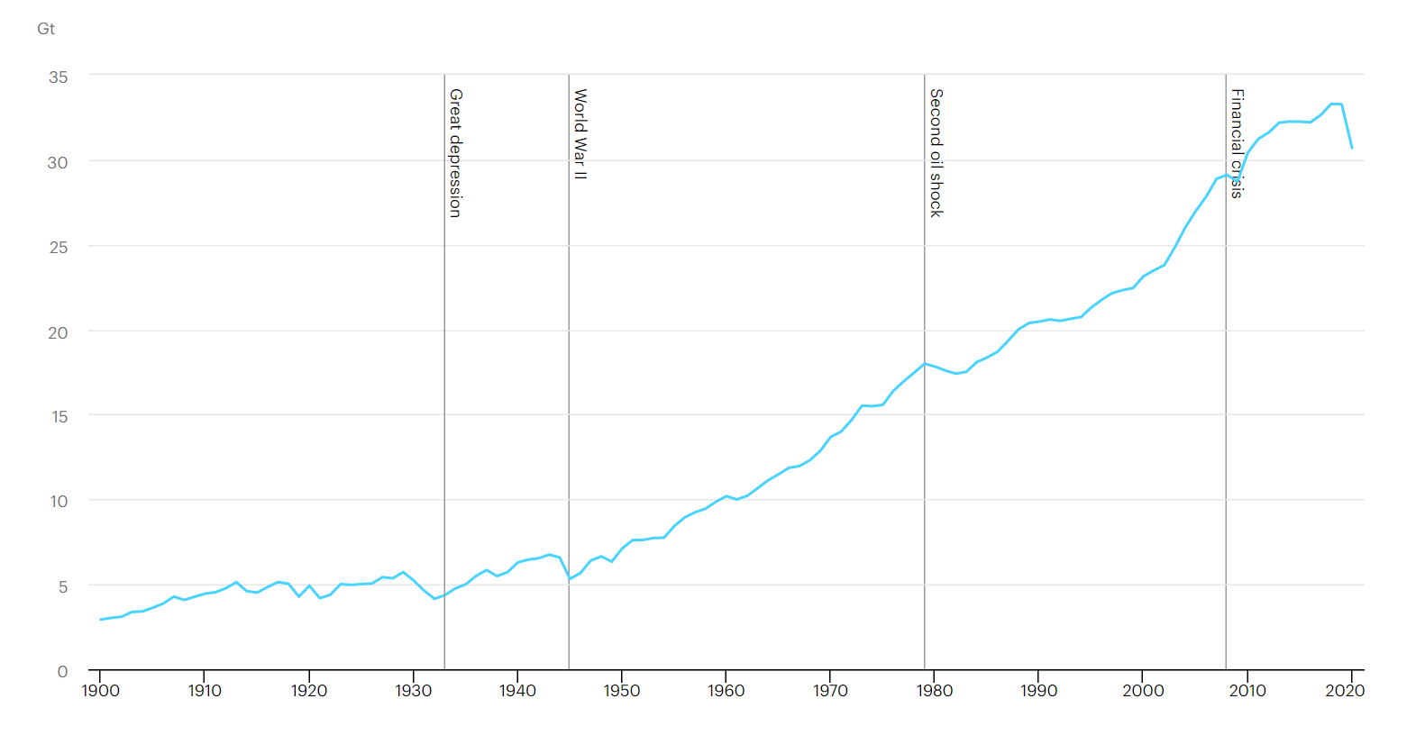
CO₂ as valuable commodity
Growth in global demand
Growth in global demand of CO₂ over the years (left); breakdown of demand in 2015 (right)
Source: Energieinstitut an der JKU based on IEA 2019, ETC (2018); IHS Markit (2018); US EPA (2018)
Notes:
some of these efforts can already be quantified, the growth rates show an upward trend with a current volume of approx. 250 million T CO2 use in Mt/year. but in relation to the level of emissions, there is clearly still almost a factor one thousand in between, talking about mega and giga tons & not accounted for in the GHG balances

Slide 4
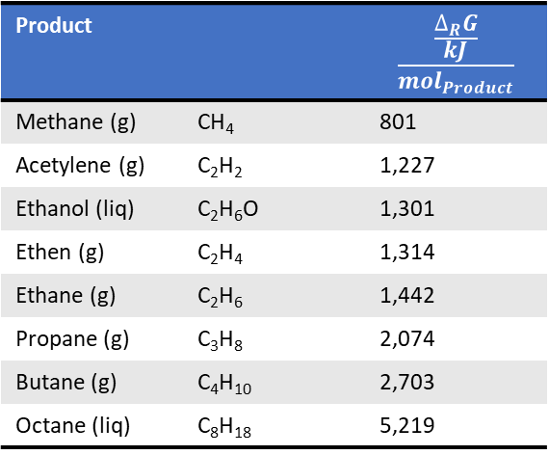
CCU – Carbon Dioxide Capture and Utilisation
CO₂ + water conversion = inverted oxidation / combustion = intrinsically energy demanding
Converting CO₂ is generally energy intensive
Also catalysed conversion fight against the 2nd principle of thermodynamics
Carbonates are special, kinetics can partly offset thermodynamic benefits
Product |  | $$\frac{\frac{∆_{R}G}{kJ}}{{mol}_{Product}}$$
Methane (g) | CH₄ | 801
Acetylene (g) | C₂H₂ | 1,227
Ethanol (liq) | C₂H₆O | 1,301
Ethen (g) | C₂H₄ | 1,314
Ethane (g) | C₂H₆ | 1,442
Propane (g) | C₃H₈ | 2,074
Butane (g) | C₄H₁₀ | 2,703
Octane (liq) | C₈H₁₈ | 5,219
Mimimum energy demand for conversion of CO₂ to products
energy
demand
Hydrocarbons
Industrial chemicals
Carbohydrates
CO₂
Urea
Carbonates
Notes:
CCU technologies developed now will certainly see a net zero carbon world, because • Expected time to market: decade(s) • Expected time to build CCU infrastructure: decade(s) • Economic life time: decades

Slide 5

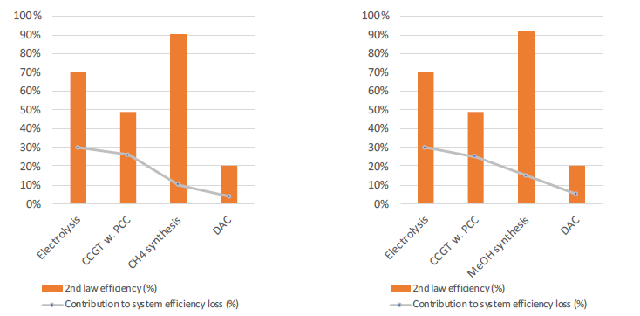
An objective view on the entire process chain
Approximated system efficiencies
Methane (g) | CH₄
Methanol (liq) | CH₃OH
Efficient hydrogen provison is a key enabler for maximized efficiency
There is much
room to improve
CCU efficiencies
CCU products are not carbon neutral of circular by default
CO₂ used ≠ CO₂ avoided
CCGT … Combined Cycle Gas Turbine
PCC … Post Combustion Capture
DAC … Direct Air Capture
Source: based on Mijndert van der Spek ETH Zürich, 20.04.2020, Dias, V. et al. Front. Mech. Eng., 29 May 2020, Bergins, C., et al. POWER-GEN Europe 2015,
Notes:
CCU fuels are circular nor carbon neutral by default • Need to be net zero CO2 to be succesful à DAC or BECC • High efficiency cost of seasonal power storage • power-CH4-power: η ~ 30% • power-MeOH-propulsion: η ~ 13% • Hydrogen most efficient; CCU needs total system analysis to evaluate its potential performance in future energy systems

Slide 6



The CO₂EXIDE project approach
Renewable inputs for sustainable process design
The project aims for sustainable environmentally friendly products, thus the focus is on
biogenic CO₂ and renewable electricity as main resources. As cost are a determining factor, further focus is on existing, high-purity CO₂-sources such as:
Biogas upgrading
Bioethanol production
P2X/CCU technologies can balance future energy systems with high shares of fluctuating renewable energy sources such as:
Photovoltaics (PV)
Wind power
Thus, the focus is on existing large PV and wind farms.

Slide 7
Potential sources of biogenic CO₂
existing, high-purity point sources in the focus
CO₂-sources
with ratio of CO₂
in the off-gas
Most important biogenic sources
are highlighted in green
Source: Rodin, V. et al. (2020) Assessing the potential of carbon dioxide valorisation in Europe with focus on biogenic CO₂, Journal of CO2 Utilization, Vol. 41, 101219

Slide 8
Biogas plant distribution in Europe
existing, high-purity point sources in the focus
10971
Biogas plant distribution
in Europe at the end of 2017
European country ranking according to the number of biogas upgrading plants in early 2017
Source: Rodin, V. et al. (2020) Assessing the potential of carbon dioxide valorisation in Europe with focus on biogenic CO₂, Journal of CO2 Utilization, Vol. 41, 101219

Slide 9
Biogenic CO₂ from biomethane production
existing, high-purity point sources in the focus
approx. 500 biogas upgrading plants to biomethane in operation in Europe
14 % of biogenic CO₂ from biogas is already separated, but hardly utilized
Significant potential of highly concentrated biogenic CO₂ for valorization
3.15 Mt/yr
CO₂ potential in Mt/year from biomethane upgrading as part of total CO₂ potential from biogas production for the EU-28 (data for 2016)
Source: Rodin, V. et al. (2020) Assessing the potential of carbon dioxide valorisation in Europe with focus on biogenic CO₂, Journal of CO2 Utilization, Vol. 41, 101219
20.00 Mt/yr

Slide 10
Biogenic CO₂ from bioethanol fermentation
existing, high-purity point sources in the focus
CCU technically feasible without extensive effort
Some production site capture the CO₂ already distribute the produced CO₂ commercially
    Dry ice
    Carbonic acid for beverages
    Fertilizer for greenhouses
2.03 Mt/yr
3.68 Mt/yr
∑ 5.71 Mt CO₂/yr
Amount of CO₂ in Mt/year produced in the EU bioethanol industry in
2016 including amount of possibly commercialized CO₂
Source: Rodin, V. et al. (2020) Assessing the potential of carbon dioxide valorisation in Europe with focus on biogenic CO₂, Journal of CO2 Utilization, Vol. 41, 101219

Slide 11
CO₂ capture
Capture costs
biogenic CO₂ in Europe
CO₂ from biogenic sources can provide lowest capture costs
Direct Air Capture (DAC) is expected to rapidly reduce its costs
In total approximately 506 Mt/yr of biogenic CO₂ are produced annually in Europe
Of which 86% imply cost intensive flue gas purification
Source: Energieinstitut an der JKU

Slide 12
Matching of biogenic CO₂ and RES sources
GIS-based analysis of potential CO₂EXIDE production sites
Based on GIS analysis tools,
existing CO₂ and renewable power sources were matched to identify possible CO₂EXIDE production sites within Europe to …
… provide 100 % renewable based products
… avoid transport of (hazardous) reagents
… support grid operation by balancing out fluctuating,
locally generated renewable energy
For the specific case studies, additionally favorable infrastructure was considered…
…ethylene producers/consumers
…pipeline infrastructure
Mapping of biogenic CO₂ sources
    existing biomethane upgrading plants (>16 kt CO₂/yr)
    existing bioethanol production sites (> 160 kt CO₂/yr)
Mapping of RES sources
    Existing onshore wind farms > 1 MW
    Existing solar power plants > 1 MW
Focus on 4 categories of plant sizes from 1 to 500 MW

Slide 13
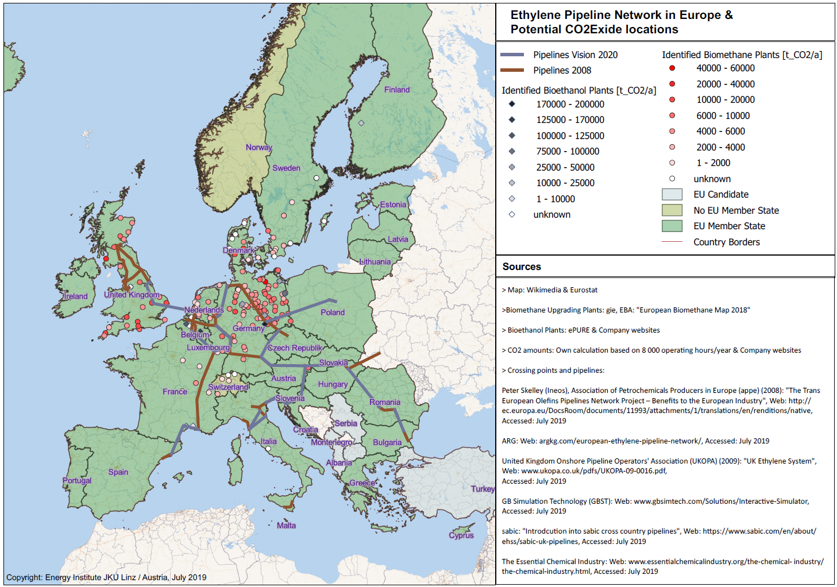



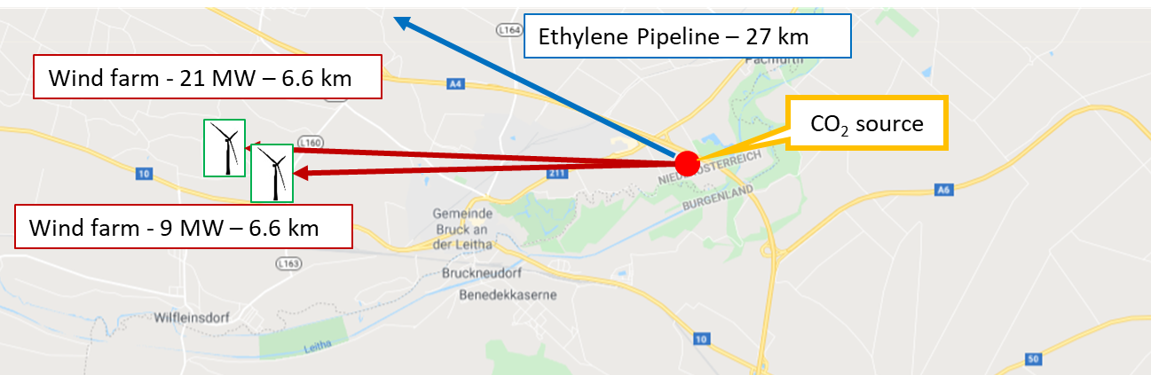
GIS based approach for roll-out scenarios
Visualisation & intersection of CO₂-point soures and renewable power plants
3 case studies in 3 countries
concidering local conditions, existing infrastuctures
Source: Energieinstitut an der JKU

Slide 14
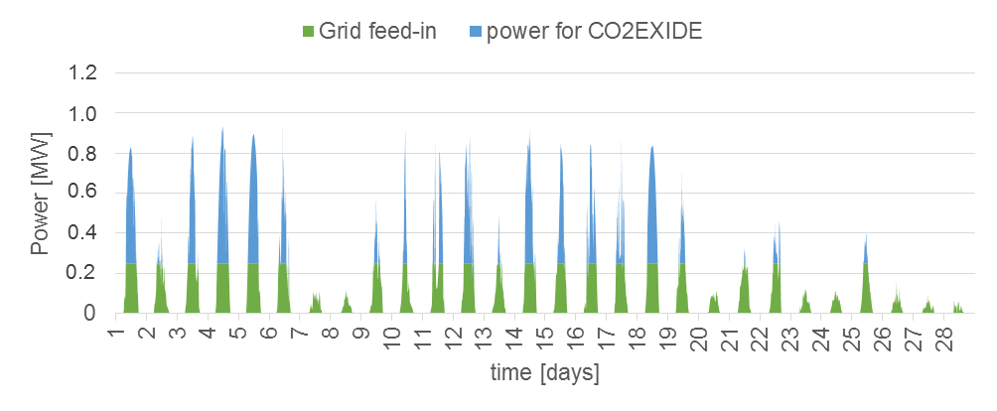
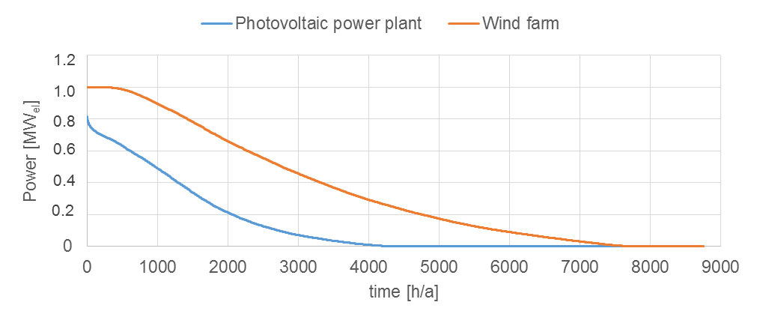
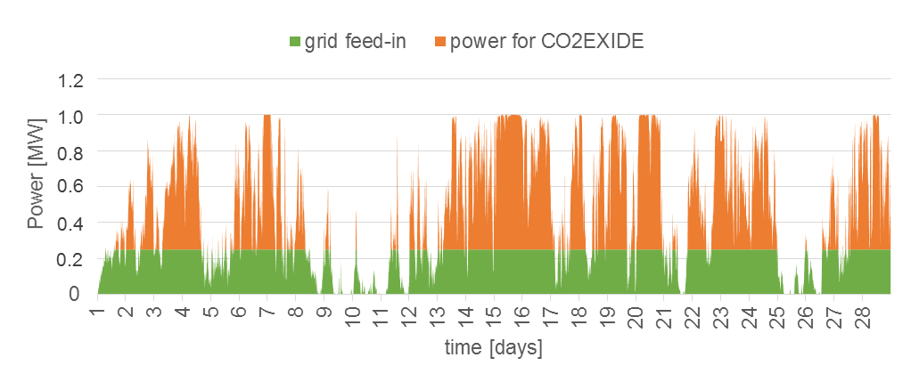


Development of specific case studies for potential technology roll-out
Modelling of fluctuating renewable power generation
Typical electricity production characteristic of a 1 MW photovoltaic power plant (top) & wind farm (bottom)
avoidance of usage competition & system inefficiencies
minimum levelized cost of CCU product
The power is divided in the share of grid feed-in and power for the potential CO2EXIDE-plant for scenario development; central european conditions applied
Source: Energieinstitut an der JKU

Slide 15
For takeway…
CCU, a promising option for CO₂ emission reductions
The scientific and technical challenges in the reductive activation, catalytic technologies for CO₂ conversion to fuels and chemcials is a dynamic field.
Achieving a net zero emissions EU energy system by 2050 based on predominantly renewables is a prerequisite.
In absence of binding international climate agreements, a sufficient high price on CO₂ emissions, CCU is actually hardly economic.
Nevertheless the need to identify the range of future-proof CCU technologies and products now due to the expected long periods to market.
As with all renewables scale up and market division needs to be linked to stringent sustainability criterias to take full advantage. A framework for analysis is currently evolving.
CO₂ use is a complement,
not an alternative to large-scale emissions reductions.

Slide 16
Our European projects in the area of technology assessments
Energy Institute activities in process assessment

Slide 17
Many thanks for your attention!

Slide 18



Further Information
Contact
Johannes Lindorfer
lindorfer@energieinstitut-linz.at
Energy Institute at the
Johannes Kepler University
Altenberger Strasse 69, 4040 Linz
Austria
Project coordination
Arne Roth
arne.roth@igb.fraunhofer.de
Fraunhofer IGB
Nobelstrasse 12, 70569 Stuttgart
Germany
www.CO2EXIDE.eu

